Slide 1
Aging Out
Dani Goddard, Lauren Hoppe, Jaclyn Jerse, Susan Kaiser, Sam Mitchell, Tiffany Poon, Johnny Rider, and Nicole Sellers
Touro University Nevada

Slide 2
“Compelling stories of ten young people whose lives are full of promise, but who face economic and social barriers stemming from the disruptions of foster care. Illustrates the need for providing youth in foster care the same opportunities on the road to adulthood that most of our youth take for granted.” (Shirk & Stangler, 2004)
Retrieved from http://ecx.images-amazon.com/images/I/41zFNv8wdyL._SY344_BO1,204,203,200_.jpg

Slide 3
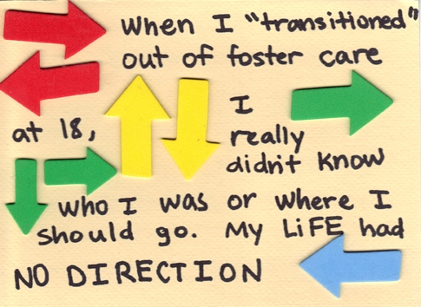
Retrieved from http://cdn3.volusion.com/akhgz.wdvrr/v/vspfiles/photos/challenges_aging_out-2.jpg

Slide 4
Group Activity
Scenario: Tomorrow is your 18th birthday. Tonight you have a place to sleep, tomorrow you have no idea where you will be sleeping. You have been in 10 different foster care homes over the past eight years. You have not had any contact with your biological parents since you were 11 years old. Your current foster care parents have five other foster children and you did not get along with them. You finished 11th grade but did not graduate high school. You do not have a birth certificate, social security card, bank account, cell phone, or driver’s license. You have a state ID card, clothes, a backpack, basic toiletries, and were given $1000 cash to help you make the transition out of foster care.
Retrieved from http://i.huffpost.com/gen/1268307/thumbs/o-ADOPTION-facebook.jpg
Notes:
Johnny and Jaclyn
Tomorrow is your 18th birthday. Tonight you have a place to sleep, tomorrow you have no idea where you will be sleeping. You have been in 10 different foster care homes over the past 8 years. You have not had any contact with your biological parents since you were 11 years old. Your current foster care parents have 5 other foster children and you did not get along with them. You finished 11th grade but did not graduate high school. You do not have a birth certificate, social security card, bank account, cell phone, or driver’s license. You have a state ID card, clothes, a backpack, basic toiletries, and were given $1000 dollars to help you make the transition out of foster care.
What do you do first?
Discuss in your groups for 5 minutes and then we will share as a class.
Additional questions to pose to the entire class: *Play devil’s advocate with answers!
How do find resources?
How do you find help?
Where do you go first?
How do you find a job?
Additional discussion:
“As parents (or as future parents), we know that our role in our children's lives goes far beyond providing them with the basics of food, clothing, and shelter. We also nurture and guide them, and as they grow older we expose them to new experiences and opportunities, encourage them to succeed in school, develop healthy relationships, and build life skills. Although adolescence can be challenging for both kids and parents, every positive interaction we have is a critical opportunity to establish the building blocks that our teens need to succeed down the road in school, work, and family life. “
When you were 18 what were your goals? Could you accomplish them with these resources and without family support? Imagine you didn’t have your parents to go for help, you didn’t have the life skills training, where would you be today?
Car
College Application
Groceries
Clothes
Cell Phone
Plane Ticket
Credit Card
Haircut
Bus Pass
Second Job
Dog
Grooming/Hygiene products
Laptop
School supplies
Shoes
Movie Tickets
Books
Savings Account

Slide 5
Foster Care
Over 510,000 children in foster care
60.5% victims of some form of neglect; 35% victims of physical abuse, sexual abuse or severe emotional abuse
Removal > “out-of-home placement” > goal for “permanency” > exit out of foster care at 18 years old
More than 20,000 young people transition out of foster care every year
(Shirk & Stangler, 2004, p. 6)
Notes:
Tiffany
Why is this population considered oppressed/marginalized based on the information we are presenting?

Slide 6
Diversity Factors
Gender | Foster Care Population
Female | 48%
Male | 52%
Age | Foster Care Population
<1 year | 7%
1-5 years | 33%
6-10 years | 22%
11-15 years | 22%
16-18 years | 16%
>19 years | 2%
(U.S. Census Bureau, 2013)

Slide 7
Diversity Factors
Race/Ethnicity | Foster Care Population
African American | 24%
Caucasian | 42%
Hispanic | 22%
American Indian/Alaska Native | 2%
Asian/Pacific Islander | 1%
Unknown | 3%
2 or more races | 6%
(U.S. Census Bureau, 2013)
Notes:
Tiff
Transition- Individuals turning eighteen within the foster care system demonstrate a different milestone in comparison to children supported by family. Their lives have been impacted tremendously disrupting the concepts of occupation due to the frequent readjustments in which they had to adapt to.

Slide 8
Diversity Factors
Average amount of time in foster care system: 28.6 months
60% adopted by their foster parent(s)
25% adopted by a relative
8% neither reunited with families nor adopted; they were emancipated and departed into world of adulthood with little to no support
(U.S. Census Bureau, 2013)
Retrieved from https://cosmiccowgirlsmagazine.files.wordpress.com/2011/08/thriving-in-spite-of-adversity-12-foster-homes.jpg
Notes:
Tiffany

Slide 9
Socioeconomic
Suppressed Financially
Poverty
Homeless - 25%
Education
High school diploma - 54%
Bachelor’s degree or higher -2%
Unemployed - 51%
No health insurance - 30%
Lack of Responsibility
Financial difficulty
Receives public assistance - 30%
Unemployment
Arrested
Incarcerated
Pregnant
Became a parent - 84%
(U.S. Census Bureau, 2013)
Notes:
Jaclyn
Several opportunities are provided by parents to the typical child raised in the care of guardians. Involved parents provide a child with discipline, responsibility, assistance, advice, support, and a role model to follow and shape their life to become self-sufficient and successful. Foster children aging out of the system are particularly at a disadvantage with the continuous readjustments in which they have to adapt to, in comparison to the opportunities and support system that many of us had when growing up.
According to the US Census Bureau 25% of these individuals are homeless and 51% are unemployed. With that being said those individuals employed had average earnings below the poverty level, and only 38% of those employed were still working one year after discharge. Because of the inadequate or lack finances 30% do not have health insurances and with trouble accessing health care, unlike you and I which are eligible to stay on our parents health insurance until age 26. As you can see, these individuals have a lot of financial responsibility leaving little incentive to graduate high school or college, because of the constant fight to juggle so many aspects at one time.
Socioeconomic issues greatly incorporate the lack of responsibility in which these individuals have. This may lead to larger issues with understanding work ethics when becoming employed. Many of these individuals do not have the first job experience like you and I had to teach them responsibilities and developing work ethics and punctuality. If one cannot obtain a job they may have a greater risk at stealing leading to becoming arrested and serving jail time which we saw throughout the reading. Another socioeconomic factor that may correlate to the lack of responsibility involves risky sexual behavior. If these individuals are experiencing financial difficulty caring for themselves, bringing a child into the mix may only bring greater complications to their lives.

Slide 10
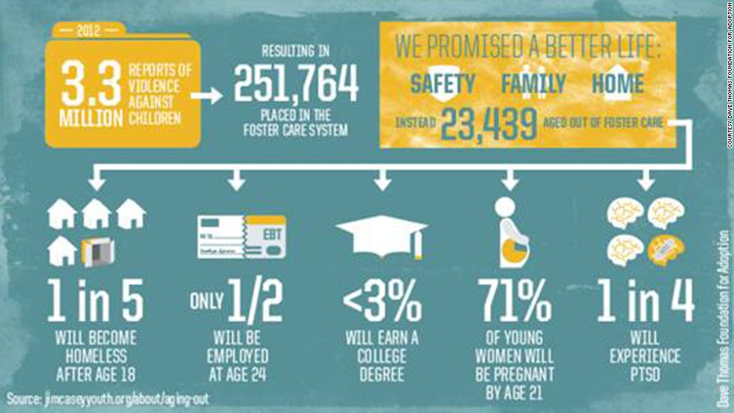
Socioeconomic
Retrieved from: http://www.cnn.com/2014/04/16/opinion/soronen-foster-children/
Notes:
Jaclyn
Here is a visual in which you can see a breakdown of statistics from 2012. These individuals walk into a society full of unknowns without certainty they will succeed and no one to approach when problems arise. They really are unable to demonstrate a “live and learn” lifestyle because one mistake can jeopardize their entire life.

Slide 11
Sociocultural
Emotional Deprivation
Neglect------Psychological Disorders
Mistrust---------------- ↓ Relationships
Loneliness-------------Social Isolation
Cultural Norms
Habits----------------Stealing, Drug-use
Instability------↑ Change of Residence
Abuse-------------------Physical/Mental
“All of my life, I’d been getting my hopes up & then being disappointed...
people keep promising me things and never follow up.”
(Shirk & Stangler, 2004, p. 87)
Notes:
Jaclyn
Foster children are not provided the guidance with the support that is considered a norm within society today. Psychosocial issues such as abuse, neglect, and mistrust forever haunt their minds, impacting participation in academics, relationships, and the ability to sustain a job. Accomplishments such as graduating high school are not shared amongst family members and friends due to the temporary foster family arrangements and the constant change in residency. They are deprived of a stable support system lacking positive encouragement, consistent direction with personal accountability, establishing relationships, and emerging in the role of responsibility. These individuals are suppressed financially and emotionally living a life controlled by a system of strangers that delegate personal decisions without consent of the child.
Sociocultural refers to the non-genetic causes and dynamics that associate with how culture and society impact an individual. The lack of stability decreases engagement with social relationships, inhibits participation with age appropriate activities, and challenges performance due to consistent impediments. These individuals suffer from emotional deprivation leading to psychological disorders such as depression because of the neglect in which they experienced. They will have trouble trusting others because they have been constantly let down leading to social isolation and difficulty developing relationships with others. Cultural norms may contribute to the habits they developed from either living on the streets or with the individuals they associate with. Many foster children are constantly being moved from one place to another place leaving them with feelings of instability and the inability to have friends to build relationships with. Although one may not have all the answers to change their circumstances.
...lauren will now explain their lifestyle choices.

Slide 12
Lifestyle Choices
Each decision comes with positive or negative outcomes
High risk population
Lack of support (Stott, 2012)
“My bad family is basically my backbone. It is what drives me. I had the childhood that was dealt to me and I don’t complain about it. I’ve always believed that it’s important to remember where you came from so you know where you want to be going” (Shirk & Stangler, 2004, p. 87).
“...be bigger than the circumstances they have been given and even if you are setup to fulfill a certain statistic somewhere, internally you have the strength and power to overcome that” (S.S, personal communication, February 10, 2015).
Notes:
Lauren The choices made by youth can make or break them when in the foster care system and their choices can follow them for the rest of their lives. Foster care children are a high risk population because they lack consistent support and have a more of a chance to fall through the cracks and get caught up in illegal activities. On the other hand there are youth within the system that have pulled through and achieved success through their life choices despite all hurdles and barriers placed in their live. Each life choice comes with positive and negative outcomes.
One story in particular highlights how different choices affect each live differently--3 brothers born, 1 year apart- most of the time placed together
all three placed in Children’s group home for abused and neglected children
2 older brothers started selling drugs and ran away from the home
**it is important to remember that foster care children have been removed from their home due to inadequate living situations. Youth entering foster care have been abused, neglected, and/or abandoned.Many were also exposed to poverty, parental substance abuse, violence in their homes and communities, and incarceration of a parent
High Risk Population:
Low education, high dropout rates, low self esteem, high mental health care needs, poor coping skills
Leads to increased engagement in risky behaviors
Drug use, risky sexual behaviors, increased involvement in illegal activity
Increased juvenile arrests and incarceration rates
With about half of youth aging out of care without a high school diploma, employment, financial stability, and housing security suffer. Indeed, up to half of young adults from foster care are unemployed at any given time; the income of the majority is below the poverty threshold; and up to 40% experience homelessness
Adolescents entering foster care more likely to
Higher Rate of mobility (moving from place to place)
Causes disruptions to their sense of emotional and social well being
Low educational achievement, school drop-out rates, identity confusion, low self-esteem, drug use, juvenile arrest and incarceration rates, increased mental health care needs, and social network disruption have all been correlated with placement instability
Adolescents likelihood of being adopted less than 5%
Story from Book- sold drugs in order to make money to buy shoes, clothes, ect.
Reference:
Stott, T. (2012). Placement Instability and Risky Behaviors of Youth Aging Out of Foster Care. Child & Adolescent Social Work Journal, 29(1), 61-83. doi:10.1007/s10560-011-0247-8

Slide 13
Population
The beliefs, values, roles, and customary practices vary and can be dependent on the influential people in their lives.
Customary practices such as returning home from college during the holidays are eliminated when there is no home to return to.
May cause increase in depression
“We are not equipped to go through this world alone” (Soronen, 2014)
Common cycle of violence and disobedience as belief, value, and role stemming from a sense of helplessness innate in the lives of these children.
(Soronen, 2014)
Notes:
Lauren
beliefs, values, roles. customary practices

Slide 14
Personal Interview #1
23 year old, female
Grew up going in and out of foster care in 4 different states until age 14 where she remained in the system until aging out at age 18
Mother had bipolar disorder and would disappear for days on end
She would be placed in custody when her mother would get hospitalized or was incarcerated
Still in contact with her biological mother and she is in contact with her three older brothers
Who were the most influential people in your life?
Her “landlords” while in an Independent Living Program
“Mike and Kelsey said that I could stay with them, but they were not registered foster parents; so in order to make this living arrangement happen, my case worker figured out that I could live with them through an Independent Living Program where they would ‘rent’ a room to me and act as my landlords. They have been the most stable family I have had… they are my family.”
1 social worker - who helped her jump through the hoops so that she could live with Mike and Kelsey and found her resources to support her as she aged out of the system
1 neighbor friend - who would feed her and let her stay the night when her mother went missing
What was the biggest hurdle/challenge you had to overcome?
“Knowing my worth and knowing I’m worthy and have a purpose. Because when you are floating from house to house you become a case file more than a person.”
What resources were offered to you as you neared the age of emancipation from foster care?
“The Independent Living Program. I felt the government had programs to help, although I feel like a lot of it goes unknown if you are in that situation and you have to actively seek it out or have someone watching out for you to find these services and help you apply for them.”
(S.S., personal communication, February 10, 2015)
Notes:
Lauren

Slide 15
Personal Interview #2
25 year old, female
Primary language is ASL
Became Deaf at age 4 from physical abuse
In foster care system from ages 8 to 18
No contact with biological parents and doesn’t want contact. 2 older brothers that stayed with parents; she has not had contact with them either but would like to
What resources were offered to you as you neared the age of emancipation from foster care?
“I don’t remember foster care really offering much help other than a list of resources. I had some money from my last foster parents, and they were my biggest support. I didn’t know how to finish high school, apply to college, get a job, and find housing or what to do. I didn’t fully understand my right to an interpreter and wondered how I would go to college. It was my goal, but I didn’t graduate high school and it was mainly my goal because everyone told me it should be.”
Were there any particularly influential people in your life who helped you prepare for living independently?
“My last foster parents. They have continued to help me financially even after I aged out of foster care, but the money was limited due to their financial limitations. I made some good friends from a Deaf youth group at my last foster home that I still associate with, and they have taught me most of what I know about living independently. They have taught me how to manage my finances, do online banking/shopping, they helped me with my GED, they even helped me with public transportation and housing. I feel most comfortable asking people my own age for help because it is embarrassing that I don’t know some things that other people my age know but they have always been kind and helpful.”
(K. T., personal communication, February 10, 2015)
Notes:
Johnny

Slide 16
Personal Interview #2 Cont.
What would you consider to be the biggest hurdle/challenge that you had to overcome or still have to overcome?
“Besides language barriers, I didn’t graduate high school and it took me almost 3 years to get my GED. I am working full-time as a janitor at an elementary school because it doesn’t require a lot of communication with co-workers. I am just now starting college classes at a community college and trying to figure out what I want to do with my life. I didn’t have much direction growing up. School was hard—I switched foster homes and schools often. I was given “goals” in life but didn’t have any of my own, and I definitely didn’t know how to achieve the goals I was told I needed to have. Not having a driver’s license was difficult. I was shocked to hear my friends had bank accounts and savings accounts. I didn’t have any of those when I turned 18. I was not a very happy person until the age of 16 when I finally felt supported and loved.”
What have you learned since you exited foster care?
“That education is very important for my future. I have met fellow adults of foster care who had it worse and some who had it better. Life isn’t fair and we have to make the best of what we have…having friends makes life a lot better. My friends are my stability, but I know I can go to my last foster parents in emergencies.”
Is there any advice you could offer to others in the foster care system to help them successfully transition to adulthood?
“Find a support group. People who had a good upbringing, who you feel comfortable with, who will help you without judging you. I would be living on the street if I didn’t have good friends and foster parents that have supported me since turning 18.”
What changes within the foster care system do you think would be most beneficial?
“I think housing for youth aging out would be beneficial. Maybe subsidized-type housing where we could be independent but have support services. Help with getting identifying documents, setting up a bank account, learning public transportation and giving us a cell phone, even it was a prepaid one for emergencies.”
(K. T., personal communication, February 10, 2015)
Notes:
Johnny

Slide 17
Personal Interview #3
16 year old, male
In and out of the foster care system his entire life, in California and Arizona
In contact with his parents: “…they are still a big part of my life.”
Two older brothers, four sisters; in contact with two of his siblings
“I think the biggest thing for me to overcome is to deal with the fact that my family has been strung out and won't ever be whole again—the fact that my family will never be close or hang out and talk, because they all despise each other and don’t really want anything to do with my parents. I guess the fact that my once "family" will never really be a family again.”
How involved are your social workers/foster representatives/foster parents in beginning your transition?
“My foster parents are extremely involved and want to see things continue to head in a positive direction, but mostly my case workers have always come to see me as little as necessary… I'm not completely sure if that was [because] they didn’t want to come see me or if it was because they wanted [it] to seem as though my life wasn’t monitored all the time.”…“I came to the conclusion that the difference was some families did it to help kids and others did it for the money.”
Have any resources been offered to you as you near the age of emancipation from foster care?
“There are subsidies that can be granted to a child of age that help them to get their own place to live and keep them going in order to give them time to get a job… The state also offers grants to children who have been in the foster care system in order for them to go to college.”
What changes within the foster care system do you think would be most beneficial?
“They should allow the children to get together and talk about things, they shouldn’t restrict them just because they are in the foster care system. The foster care workers need to be evaluated more before being allowed to become a foster care worker—that includes all case managers as well as foster parents.” (D. T., personal communication, February 11, 2015)
Notes:
Sam
Dani is now going to talk about the impact of being in the foster care on the development of these children

Slide 18
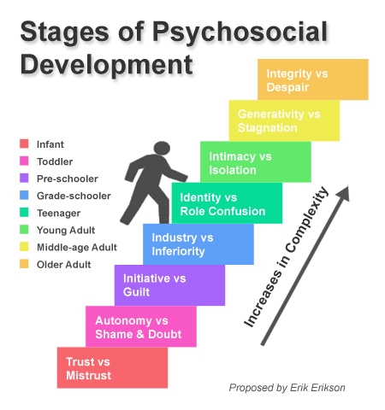
Developmental Perspective
Adolescence: developing identity, value independence and autonomy
Emerging adulthood (Arnett, 2000)
This stage has been critiqued as only being relevant to advantaged youth who have the opportunity to explore their identities and futures
U.S. culture has now shifted the age of independence and autonomy
“Off-time transitions restrict options, exacerbate adversity, and strain coping and social support systems.” (Greeson, 2013)
Retrieved from https://cognitivedaily.wordpress.com/2012/05/15/8-stages-of-psychosocial-development/
Notes:
Dani

Slide 19
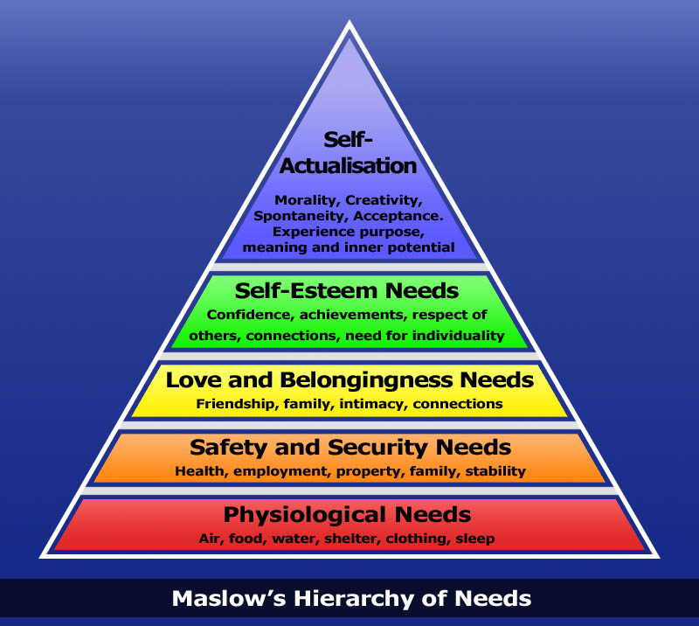
Developmental Perspective
Maslow’s Hierarchy of Needs
The importance of the “safety net”
Example of finances (Greeson, 2013):
⅔ of young adults in their early 20s still receive financial support from parents
40% still receive support into their late 20s
"We go from 'you're in foster care, where you may handle $10 a month' to 'you're responsible for everything,’” Diane Zambito, advocate for youth in transition from care (Fessler, 2010)
How can kids & teens be expected to be successful if their more “basic needs” are going unmet?
Retrieved from http://blog.simcrest.com/using-maslow-s-hierarchy-of-needs-in-communications-128
Notes:
Dani

Slide 20
Occupational Injustice
Apartheid: too systematic/formalized
***Deprivation: “...a state of preclusion from engagement in occupations of necessity and/or meaning due to factors that stand outside of the immediate control of the individual” which causes “pervasive and long-term effects on individuals and can also have significant health implications”
Alienation: “...prolonged experience of disconnectedness, isolation, emptiness, lack of sense of identity…”
Marginalization: “...results from informal norms and expectations…”
Imbalance: societal level (not offered as many options for occupational engagement as same-aged peers), personal level (“excessive amount of time spent occupied in one area of life at the expense of others,” i.e. working too much to try to save for emancipation, spending time adjusting to new homes) (Durocher, Gibson, & Rappolt, 2013)
Notes:
Dani
Durocher, E., Gibson, B. E., & Rappolt, S. (2013). Occupational Justice: A Conceptual Review. Journal of Occupational Science, 21(4), 418-430. doi: 10.1080/14427591.2013.775692

Slide 21
Occupational Engagement
Commonly, foster care youth have decreased opportunity and resources in all aspects
Need assistance to further engage in:
School life
Cultural and natural resources and opportunities
Applying and remaining in college
Employment
Housing
Health care
Personal/community engagement
Mentoring
(Shirk & Stangler, 2004)
Notes:
Nicole
areas affecting health and well being due to population-play occupation as children-hobbies, roles, and careers as we transition to adulthood
AVOID TRANSITION
"bad events have stronger and more lasting consequences than comparable good events. Close relationships are more deeply and conclusively affected by destructive actions than by constructive ones.“ (Piraino, 2015)
Two key strategies are to reduce the adverse childhood experiences and strengthen relationships that protect children from the effects of stress
In particular, having a relationship with a caring adult outside the family has a meaningful impact on an at-risk child's well-being. These relationships can help children learn to stay calm, be interested in learning, care about school, get more exercise, join after school activities, and avoid bullying.
There are evidence-based ways to help children develop a growth mindset. The evidence of this approach's impact on educational success is particularly encouraging
CASA (case appointed special advocates)

Slide 22
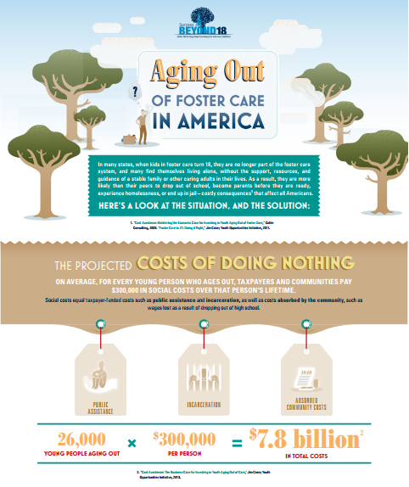
“The Cost of Doing Nothing”
“A study issued in May 2013 by the Jim Casey Youth Opportunities Initiative -- and illustrated in a new infographic -- shows that, on average, for every young person who ages out of foster care, taxpayers and communities pay $300,000 in social costs like public assistance, incarceration, and lost wages to a community over that person's lifetime.” (Stangler, 2013)
That is a projected $8 billion in social costs every year
Retrieved from http://www.jimcaseyyouth.org/sites/default/files/SuccessBeyond18InfographicHandout.pdf
Notes:
Nicole

Slide 23
Vital Needs to Support Transitions
Facilitate meaningful relationships/mentorships
Involve youth in planning their futures
Minimize moves (homes and schools)
Raise your expectations
Recognize the potential pull of family
Provide vital records & identification
Make life skills training meaningful (home management, financial management, health & wellness, career and education counseling)
Help adolescents establish savings & plans
(Shirk & Stangler, 2004, p. 262)
Notes:
Johnny
Strengthening Practice (Shirk and Stangler, 2004, p. 262)

Slide 24
What Needs to Change?
Youth need families and stability
18 is too young (raise the age of emancipation to 21 nationwide)
Programs are not well-known and vary between states
(Shirk & Stangler, 2004)
Youth need influential and consistent mentors
Importance of “natural mentors”
Characteristics of good mentors: affirmation, attention, availability, authenticity, companionship, empathy, respect, and trust
Instrumental/tangible support vs. emotional support
(Greeson, 2013; Munson, Smalling, Spencer, Scott, & Tracy, 2010)
Notes:
Johnny
(Shirk and Stangler, 2004, p. 269) Focusing on policy.
Munson, M. R., Smalling, S. E., Spencer, R., Scott, L. D., & Tracy, E. M. (2010). A steady presence in the midst of change: Non-kin natural mentors in the lives of older youth exiting foster care. Children and Youth Services Review (32), 527-535. doi:10.1016/j.childyouth.2009.11.005
key characteristics of these supportive people were their acceptance of the young person, constant encouragement, reliability, and ability to provide assistance when needed.
trust, love, caring and experiencing a natural mentor like a parent were salient characteristics endorsed
different types of social support from natural mentors were important to the older youth, such as emotional support, informational support and appraisal support
youth valued respect, mutuality and authenticity in these relationships. Mutual respect, limit-setting, listening, empathizing and genuine understanding were discussed as critical to developing connections with caring adults
(a) types of natural mentors, (b) qualities of these mentors, (c) qualities of the natural mentoring relationships, and (d) the nature of the various forms of support these relationships offered to the youth participants at this critical time in their lives
(a): Friend of the family or staff of former placement
(b): “down to earth,” “funny,” “honest/truthful,” “humble,” “kind,” “easy going” and “good personality.” Being an understanding person was a quality that these youth experienced as making their natural mentors easier to relate to and something that distinguished these adults from some of the other adults in their lives; close in age; similarity in terms of life experiences, personalities, interests or background;similar struggles/challenges
(c) : Consistency of mentors; maintaining contact; “always there”; longevity; trust; authenticity; respect; empathy
(d): keeping youth on “track”: Direct and honest feedback from the mentors seemed to play a key role in this process; actions and decisions respected by mentors; instrumental/tangible support: informational support in a variety of areas, such as education, relationships, and making the transition to adult life, how to manage their transition to adulthood and the heightened responsibility and independent decision-making associated with these changes. This included advice on money and budgeting, (“Don't buy all new stuff when you move out”), household management, employment, and career development. Youth also stated their mentors had given them general life management tips.;
emotional support: mentors had helped them think about difficult aspects of their lives in new ways and “break(ing) down things to make me understand them more clearly”

Slide 25
Aging Out in Nevada
Nevada Child Protective/Welfare System
Three regional / county service areas:
Rural (DCFS); Northern/Washoe(WCDSS); Southern/Clark (CCDFS)
Nevada Independent Living (IL) Program
Provides assistance with transitioning from foster care to self-sufficiency
Eligibility:
Anyone currently in foster care between the ages of 15 and 18
Youth who aged-out at 18 (may continue receiving services until 21)
Foster youth adopted on or after their 16th birthday
The Fostering Connections to Success and Increasing Adoptions Act of 2008
Former foster youth who aged-out in another state & reside in Nevada
(Nevada Department of Health & Human Services Division of Child & Family Services, n.d.)
Notes:
Sue

Slide 26
Aging Out in Nevada
Prior to 2011, Nevada foster youth had two options upon turning 18:
Opt out of the system altogether and be completely on their own
Stay under the court’s jurisdiction until age 19
The passage of AB350 in 2011 gave foster youth a third option:
Enroll in AB350 with access to services until age 21
Still under court’s jurisdiction, but with more freedom / fewer restrictions
Currently, 360 young adults (18-21) are enrolled in AB350 in Clark County
Benefits include a monthly stipend of ~ $780
Client must develop a written transition plan (with guidance of support worker or attorney) with goals and steps to achieve those goals
Requires that every 17-year-old receive attorney services
Assist in deciding to stay under court’s jurisdiction or become independent
Advocate for youth (with matters regarding DFS)
(Clark County Department of Family Services, n.d.; K.N., IL Specialist, personal communication, February 18, 2015)
Notes:
Sue

Slide 27
Nevada Independent Living Program
Federal Funding Sources
Chafee Foster Care Independent program (state grants)
Approximately $123,000 / year (based on availability of funds)
Target ages: 15 up to 18; portion must be used for eligible 18 to 21-year-olds
Also eligible: aged-out in another state; adopted at or after age 16
Rules for what funds can and cannot be used for
Educational and Training Vouchers (ETV)
Youth who have aged out of foster care
Youth adopted on or after their 16th birthday (from foster care)
Up to $5,000 per school year (tuition & fees, room & board, child care, books, supplies, school transportation)
State Funding Sources
FAFFY - Financial Assistance to Former Foster Youth (AB94)
Approximately $129,000 / year (based on availability of funds)
Nevada youth 18-21, assistance with attaining self-sufficiency
Foster youth age 17 who will be leaving foster care at 18 receive transitional services
(Nevada Department of Health & Human Services Division of Child & Family Services, n.d.)
Notes:
Sue

Slide 28
Independent Living Program
Clark County Department of Family Services
Approximately 3,000 children in foster care in Clark County (CCDFS)
Collaborate with various community agencies to offer independent living services
Youth ages 15 and older in foster care
Support services to help youth make the transition from foster care to self-sufficiency.
Youth are made aware of legal services available to them through LACSN
Ansell-Casey assessment tool (free, public domain instrument)
Assesses educational status, money management, social development, job readiness, & daily living skills
Assists with establishment of youth-driven, self-sufficiency goal achievement plan
Youth ages 18 - 21 (must have turned 18 while in foster care)
Services in Clark County are offered through the Step Up Program
(Clark County Department of Family Services, n.d.)
Notes:
Sue

Slide 29
Independent Living Resources
SAFY (Specialized Alternatives for Families and Youth) of Nevada
Youth ages 16 - 18 currently in foster care
Skills to assist with transitioning from youth in foster care
to self-sufficient adulthood
Classes only, no financial assistance
Financial Mgt / Budgeting Skills
Career / Educational Planning
Tax Preparation
Basic Life Skills
(Specialized Alternatives for Families and Youth, 2015)
Retrieved from http://www.safy.org/programsServices/independentLivingProgram.aspx
Notes:
Sue

Slide 30
Independent Living Resources
Step-Up Independent Living Program
Former foster youth ages 18-21
(must have remained in foster care until age 18 to be eligible)
State funded FAFFY program
Support with transitioning from foster care to self-sufficiency
Substance abuse education, assistance with obtaining a
high school diploma, birth certificate, health card
Living assistance - food, clothing, affordable housing, transportation, medical care, job training, educational assistance
Independent living services extended to youth who aged out of care in another state
(Clark County Nevada Social Services, n.d.)
Retrieved from http://www.clarkcountynv.gov/Depts/social_service/Services/pages/Step-up.aspx
Notes:
Sue

Slide 31
Independent Living Resources
Nevada Partnership for Homeless Youth
Independent Living (transitional housing) Program
~ 20% of youth experience homelessness within 2 years of aging out of foster care
48 out of 162 clients spent time in foster care; 5 aged-out; 7 ran away before turning 18 making them ineligible for other programs
Serves all youth ages 12 through 18 (or 19 if graduate from program)
Youth live with house parents in condos throughout Clark County
School enrollment and/or full-time work is requirement
Must save ½ of income (returned upon graduation)
Daily contact with support staff
Weekly life skills classes, counseling
(FosterClub, n.d.; Nevada Partnership for Homeless Youth, 2015)
Retrieved from http://www.nphy.org/what-we-do/independent-living-program/
Notes:
Sam

Slide 32
Occupational Therapist’s Role
Transitions are “actions coordinated to prepare for or facilitate a change, such as from one functional level to another, from one life [change] to another, from one program to another, or from one environment to another” (AOTA, 1998, p. 866).
Examine five aspects of performance facilitating/ hindering performance
Provide education regarding health care
Teach social or interpersonal skills, cognitive skills, emotional coping skills
Provide knowledge and skills regarding transition services
School-based practice
Increasing the number and variety of community places
Assisting in developing and expressing autonomy
Build experiences and supports
Develop valued roles and places in the community
Development of relationships and friendships
Create access to the social network of community
(Craig & Orentlicher, 2004)
Retrieved from: http://harrisonhomes.org/special-programs/life-skills/
Notes:
Sam
Many of the programs we just discussed are headed by education providers, social workers, foster parents, and community volunteers. However, I am sure you are by now thinking there is a definite role for OT with this population. Transitions are defined by AOTA as “actions coordinated to prepare for or facilitate a change, such as from one functional level to another, from one life [change] to another, from one program to another, or from one environment to another.” We are all affected by the problems of aging and by being forced into a realm that we are not prepared for. For these young people, it is turning 18. For some of us, it might be turning 30 or retirement at 65. These transitional periods put us in places where we need sufficient preparation. Occupational therapist have a role in the transitions that people go through in life. We have a role in educating them with social and interpersonal skills, cognitive skills, emotional, and coping skills.
We can examine the 5 aspects of performance (performance skills, performance patterns, client factors, activity demands, and context) and what is facilitating or hindering their occupational performance. We can serve as advocates for this population providing education regarding health care they may have no experience with benefits or cost and may need more education regarding these topics.
Currently the most common place OTs work in adolescent transitional programs is through school based practice. An article by Craig and Orentlicher states that OTs have a role by(1) increasing the number and variety of community places students know and use; (2) assisting students in developing and expressing autonomy in both everyday and life-defining matters; (3) building experiences and supports so students can perform functional, age-appropriate, and meaningful activities; (4) ensuring that students develop valued roles and places in community life; and (5) creating access for students to the social network of community and ensuring the development of personal relationships and friendships.These suggestions are offered for incorporating person-centred principles into school-based occupational therapy service delivery but can also be used in any adolescent transitional program.

Slide 33
Emerging Practice
Potential for occupational therapy employment opportunities:
School based transitional programs
Community based transitional programs
Life skills training
Youth engagement programs
Support groups
Retrieved from http://www.ehow.com/how_5767271_start-life-skills-training-center.html
Notes:
Sam
I mentioned OTs role in a school based transitional program but other potential employment opportunities include:
Community based transitional programs
Life skills training
Youth engagement programs
Support groups-like I mentioned in my interview one of the areas he saw growth within the foster care system is providing support groups made up of other foster care children to compare and work through their experiences together.

Slide 34
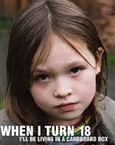
Conclusion
Financially, emotionally, psychologically, and physically oppressed population
Psychosocial concerns/“Trash bag mentality”: What message is society sending to foster youth in transition? (Piraino, 2015)
Product of the resources provided through foster care services and familial relationships
Inconsistent access to and lack of proficient programs nationwide
Need for community and school programs to educate and provide occupation-based engagement
Retrieved from http://afamilyforeverychildblog.blogspot.com/2012/09/why-this-foster-kid-blo.html
Notes:
Nicole
http://www.huffingtonpost.com/michael-piraino/no-more-trashbag-kids_b_6656966.html
http://framework.latimes.com/2014/04/30/aging-out-voices-from-those-in-the-foster-care-system/
Holidays or major events
“Trash bag” mentality
Kids can easily get the message that they do not deserve a permanent home and they are no more valuable than rubbish.
Turning 18 represents being “on your own,” but often in a scary way
Aging out represents a “failure of permanence”
So our foster youth have experienced severely adverse childhood experiences that are further reinforced by the ways they experience foster care.
Every child under the care and protection of the state due to abuse or neglect deserves to have a caring adult whose commitment is to say "I am for the child®". An adult whose very presence will convince a child that he or she is no trashbag kid, no paycheck kid.

Slide 35
Video
“First Person: Aging Out of Foster Care” https://www.youtube.com/watch?v=fs5OKeEav10
“Aging Out: Life After Foster Care” https://www.youtube.com/watch?v=E3v6Qz9PYDQ
NPR: “Reflections on Aging Out” http://www.npr.org/templates/story/story.php?storyId=125594259
Notes:
“First Person: Aging Out of Foster Care” (uplifting interview with a CASA advocate and former foster child) (3:25)
“Aging Out: Life After Foster Care” (trailer… kind of old-school, but a decent synopsis)(1:29)
NPR: “Reflections on Aging Out” (synopsis of 2 stories… collection of still-frame photos with background narrative) (2:29)

Slide 36
References
American Occupational Therapy Association. (1998). Standards of practice. American Journal of Occupational Therapy, 52, 866–869.
Clark County Department of Family Services. (n.d.). Independent living. Retrieved from http://www.clarkcountynv.gov/Depts/family_services/Services/Pages/IndependentLiving.aspx
Clark County Nevada Social Services. (n.d.). Step-Up. Retrieved from http://www.clarkcountynv.gov/Depts/social_service/Services/pages/Step-up.aspx
Craig, M. A., & Orentlicher, M. L. (2004). The role of occupational therapy in providing person-centred transition services: Implication for school based practice. Occupational Therapy International, 11(4), 209-228. doi: 10.1002/oti.212
Cunningham, M. J., & Diversi, M. (2013). Aging out: Youths’ perspectives on foster care and the transition to independence. Qualitative Social Work, 12(5), 587-602. doi: 10.1177/1473325012445833
Durocher, E., Gibson, B. E., & Rappolt, S. (2013). Occupational justice: A conceptual review. Journal of Occupational Science, 21(4), 418-430. doi: 10.1080/14427591.2013.775692
Fessler, P. (2010). Report: Foster kids face tough times after age 18. Retrieved from http://www.npr.org/templates/story/story.php?storyId=125594259
FosterClub. (2015). Why FosterClub? Retrieved from https://www.fosterclub.com/article/about-us
Greeson, J. K. P. (2013). Foster youth and the transition to adulthood: The theoretical and conceptual basis for natural mentoring. Emerging Adulthood, 1(1), 40-51. doi: 10.1177/2167696812467780
Munson, M. R., Smalling, S. E., Spencer, R., Scott, L. D., & Tracy, E. M. (2010). A steady presence in the midst of change: Non-kin natural mentors in the lives of older youth exiting foster care. Children and Youth Services Review, 32, 527-535. doi:10.1016/j.childyouth.2009.11.005

Slide 37
References
Nevada Department of Health & Human Services Division of Child & Family Services. (n.d.). Independent Living Program. Retrieved from http://dcfs.nv.gov/Programs/CWS/IL/
Nevada Partnership for Homeless Youth. (2015). Independent Living Program. Retrieved from http://www.nphy.org/what-we-do/independent-living-program/
Piraino, M. (2015). No more trashbag kids. Retrieved from http://www.huffingtonpost.com/michael-piraino/no-more-trashbag-kids_b_6656966.html
Shirk, M., & Stangler, G. (2004). On their own: What happens to kids when they age out of the foster care system. Boulder, CO: Westview Press.
Soronen, R. (2014). We are abandoning children in foster care. Retrieved from http://http://www.cnn.com/2014/04/16/opinion/soronen-foster-children/
Specialized Alternatives for Families and Youth. (2015). Independent Living Program. Retrieved from http://www.safy.org/programsServices/independentLivingProgram.aspx
Stangler, G. (2013). Aging out of foster care: The cost of doing nothing affects us all. Retrieved from http://www.huffingtonpost.com/gary-stangler/aging-out-of-foster-care-_b_3658694.html
Stott, T. (2012). Placement instability and risky behaviors of youth aging out of foster care. Child & Adolescent Social Work Journal, 29(1), 61-83. doi:10.1007/s10560-011-0247-8
U.S. Census Bureau, (2013). Characteristics of children under 18 years by age, race, and hispanic or latino origin, for the United States: 2013. Retrieved from: http://www.fostercarealumni.org/resources/foster_care_facts_and_statistics.htm

